Slide 1



Compassionate leadership
Part of the DNA of Care Programme

Slide 2
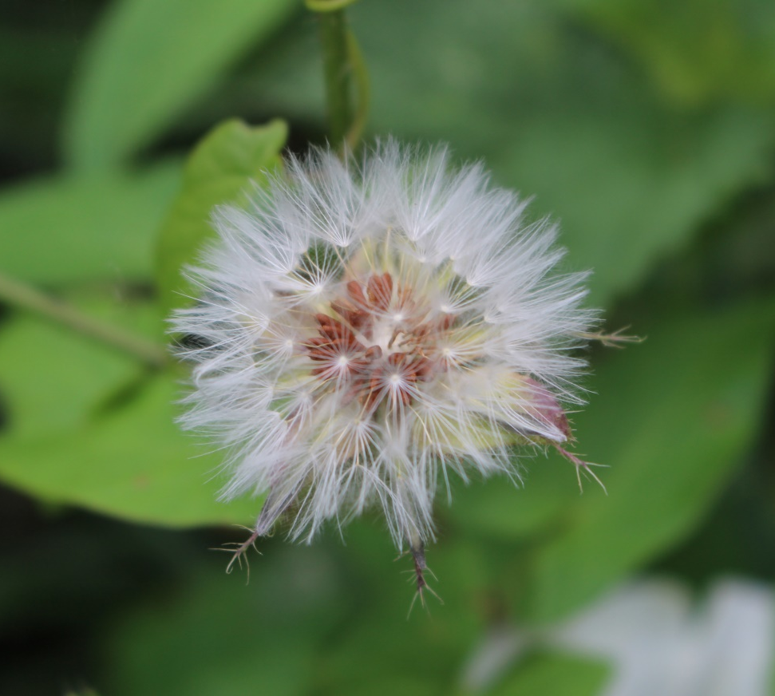
Creating cultures of compassion
‘If we want to create cultures of high-quality, compassionate care, then we need to have leaders who embody the value of compassion as part of their continually-improving, high-quality leadership.’
Michael West
Photo © Pip Hardy

Slide 3
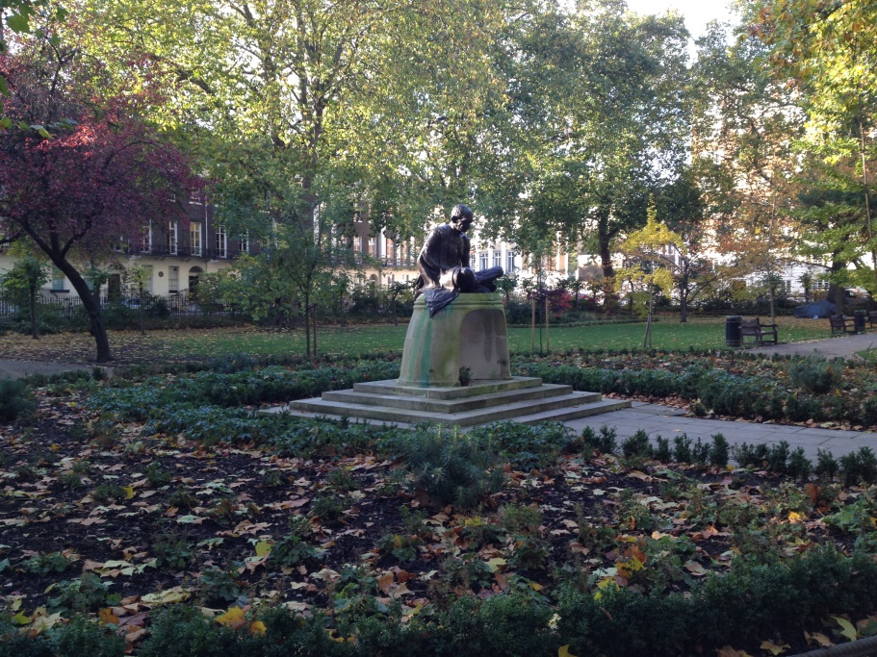
What do compassionate leaders do?
Promote equality, value diversity,
challenge power imbalances
Foster ‘intelligent kindness’
Pay attention
Photo © Pip Hardy

Slide 4

Sharing values and vision
‘If you want to build a ship, do not start by gathering wood,
cutting planks and assigning tasks.
Instead, inspire a longing for the wide, endless sea.’
Antoine de St Exupery, 1943

Slide 5
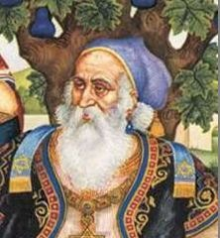
Sharing values and vision
‘If I am not for myself, who will be for me?
If I am for myself alone, what am I?
If not now, when?’
Hillel the Elder
Public narrative
  The story of me
  The story of us
  The story of now

Slide 6
Compassionate leadership and quality improvement
Connect patient experience with staff experience
‘People feel engaged because they’ve
been listened to, not just told what to do.’
Andrew Higham

Slide 7

The DNA of Care
‘The intertwined relationship between patient care and staff well-being has been likened to the double helix. And so the stories we tell each other are like the DNA of care, transmitting information and shaping cultures, offering learning opportunities and, sometimes, healing.’
Pip Hardy and Tony Sumner, 2016

Slide 8
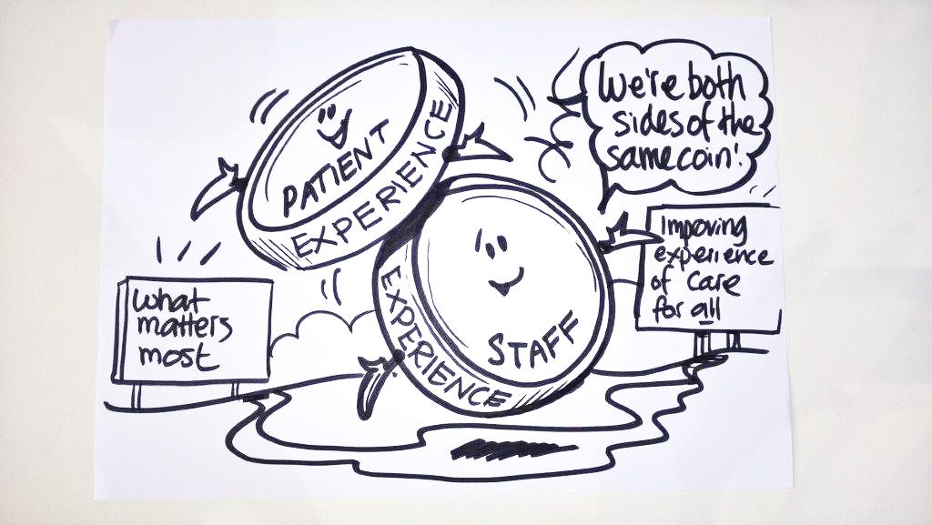
Two sides of the same coin
Staff experience drives patient experience.
‘Focusing on this relationship could be the most important move for the healthcare system to make.’
Karen Deeny, 2017

Slide 9
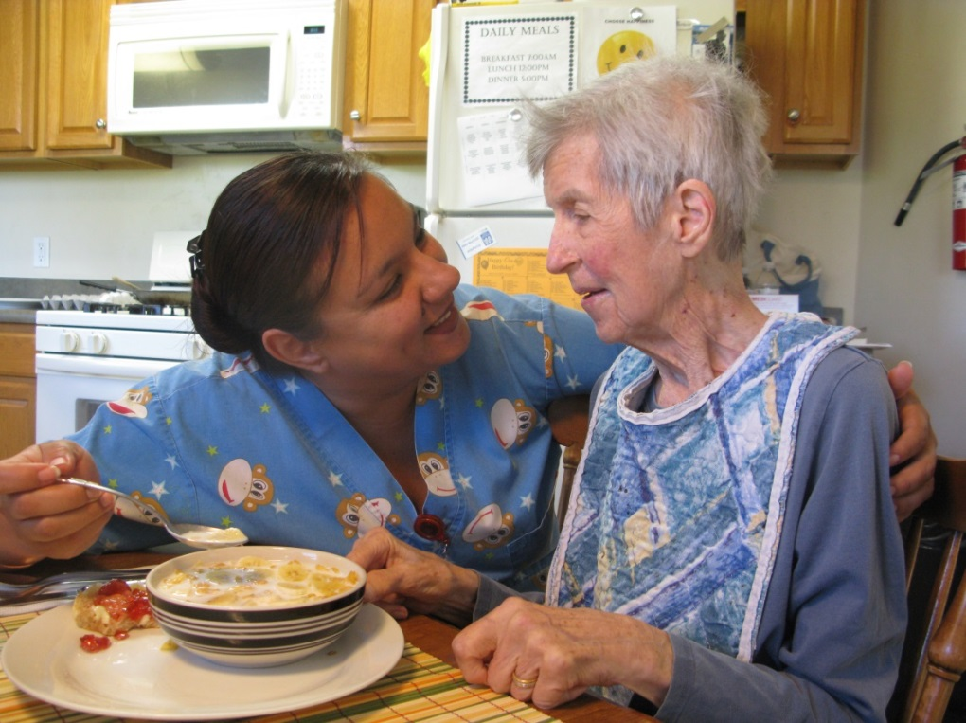
Compassion for all
‘Both staff and patients need care, compassion and respect.’
Professor Michael West 2014
Photo © Pip Hardy

Slide 10
DNA of Care stories of compassionate leadership
Stay
Floristry, perhaps?
The light on the water
Touch
Just five minutes more

Slide 11
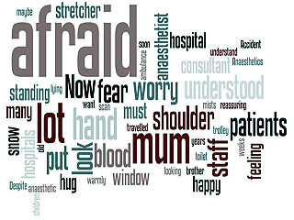
Touch
www.patientvoices.org.uk/flv/1006pv384s.htm Damon Kamming 2016

Slide 12

The light on the water
www.patientvoices.org.uk/flv/1025pv384s.htm Karen Deeny 2016

Slide 13
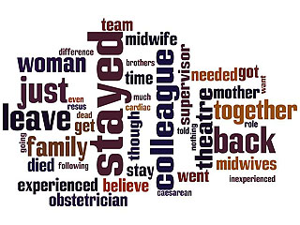
Stay
www.patientvoices.org.uk/flv/1019pv384s.htm Rachel Scanlan 2016

Slide 14
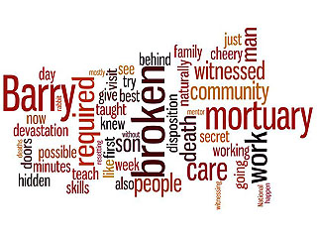
Just five minutes more
www.patientvoices.org.uk/flv/1013pv384s.htm Michelle Lancaster 2016

Slide 15

Floristry, perhaps?
www.patientvoices.org.uk/flv/1018pv384s.htm Lizz Summers 2016

Slide 16
Questions for reflection
How do the stories illustrate the impact of compassionate leadership in relation to situations inside and outside of work?
What actions are illustrated in the stories in relation to modelling compassionate leadership?
How might these stories inspire compassionate leadership?

Slide 17
Questions for reflection
How might these stories support leaders to create more compassionate cultures and the sharing of stories?
How do the stories focus attention on the difference that compassionate leadership grounded in listening can make?
What three things does this story focus our attention on, in terms of what we should do next?
Having seen XX story, what is the one thing you feel compelled to do immediately?

Slide 18
Questions for reflection
How do these stories/this story connect with your own values or the things that really matter to you?
What concerns does ‘Floristry perhaps?’ raise about the impact of the absence of compassionate leadership?
How does ‘Five minutes more’ focus our attention on the value of compassionate leadership?

